Slide 1



Mars in 3D: Creating Accessible Planetary Science Education
Alexandra Kupersmith
College of Science; Physics & Astronomy
Dr. Steve Kortenkamp
College of Science; Lunar and Planetary Laboratory
Space Grant Symposium
April 20th, 2024

Slide 2
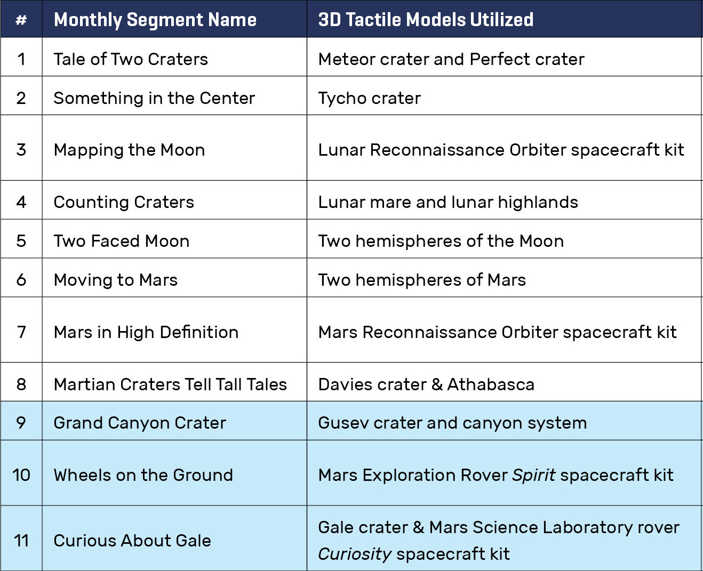


Touching Our Solar System: POEM
Project-based learning Opportunities and Exploration of Mentorship
STEM opportunities for students with visual impairments
Source: NSTA
Notes:
NGSS Funded Program.

Slide 3
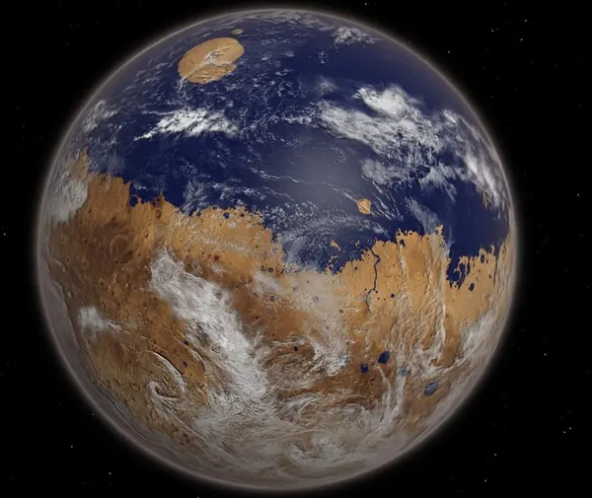
“Mars Was an Ocean World”
The Martian Surface as a Whole.
Concluding Martian Modules.
Source: Forbes

Slide 4
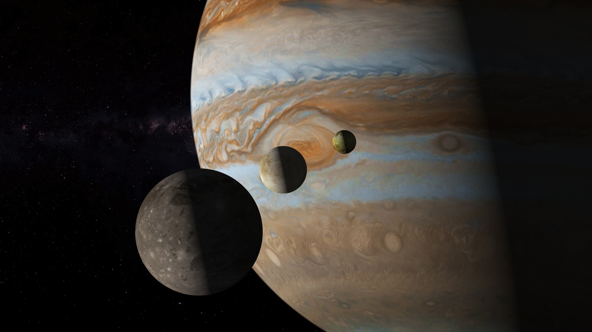
“Beyond the Habitable Zone”
Galileo Spacecraft.
Volcanism on Io.
The Water-Ice Crust of Europa.
Source: Explorersweb

Slide 5
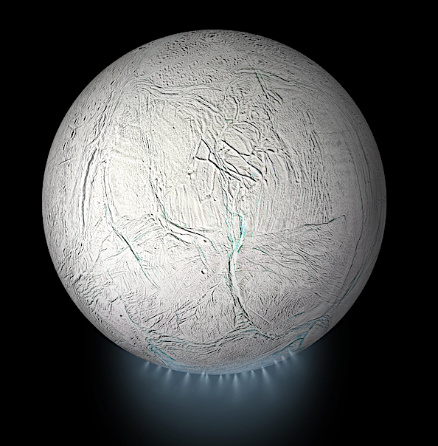
“Tiger Stipes”
Cassini Space Probe.
Surface Depressions and Plumes of Enceladus.
Source: The Astrobiology Web

Slide 6
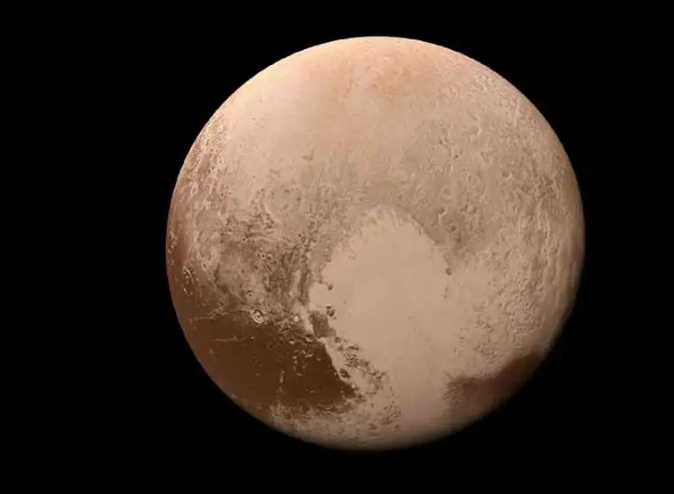
“Into the Kuiper Belt”
Mantle of Water Ice.
Nitrogen Lakes.
The presence of Geological Activity.
Source: NASA

Slide 7
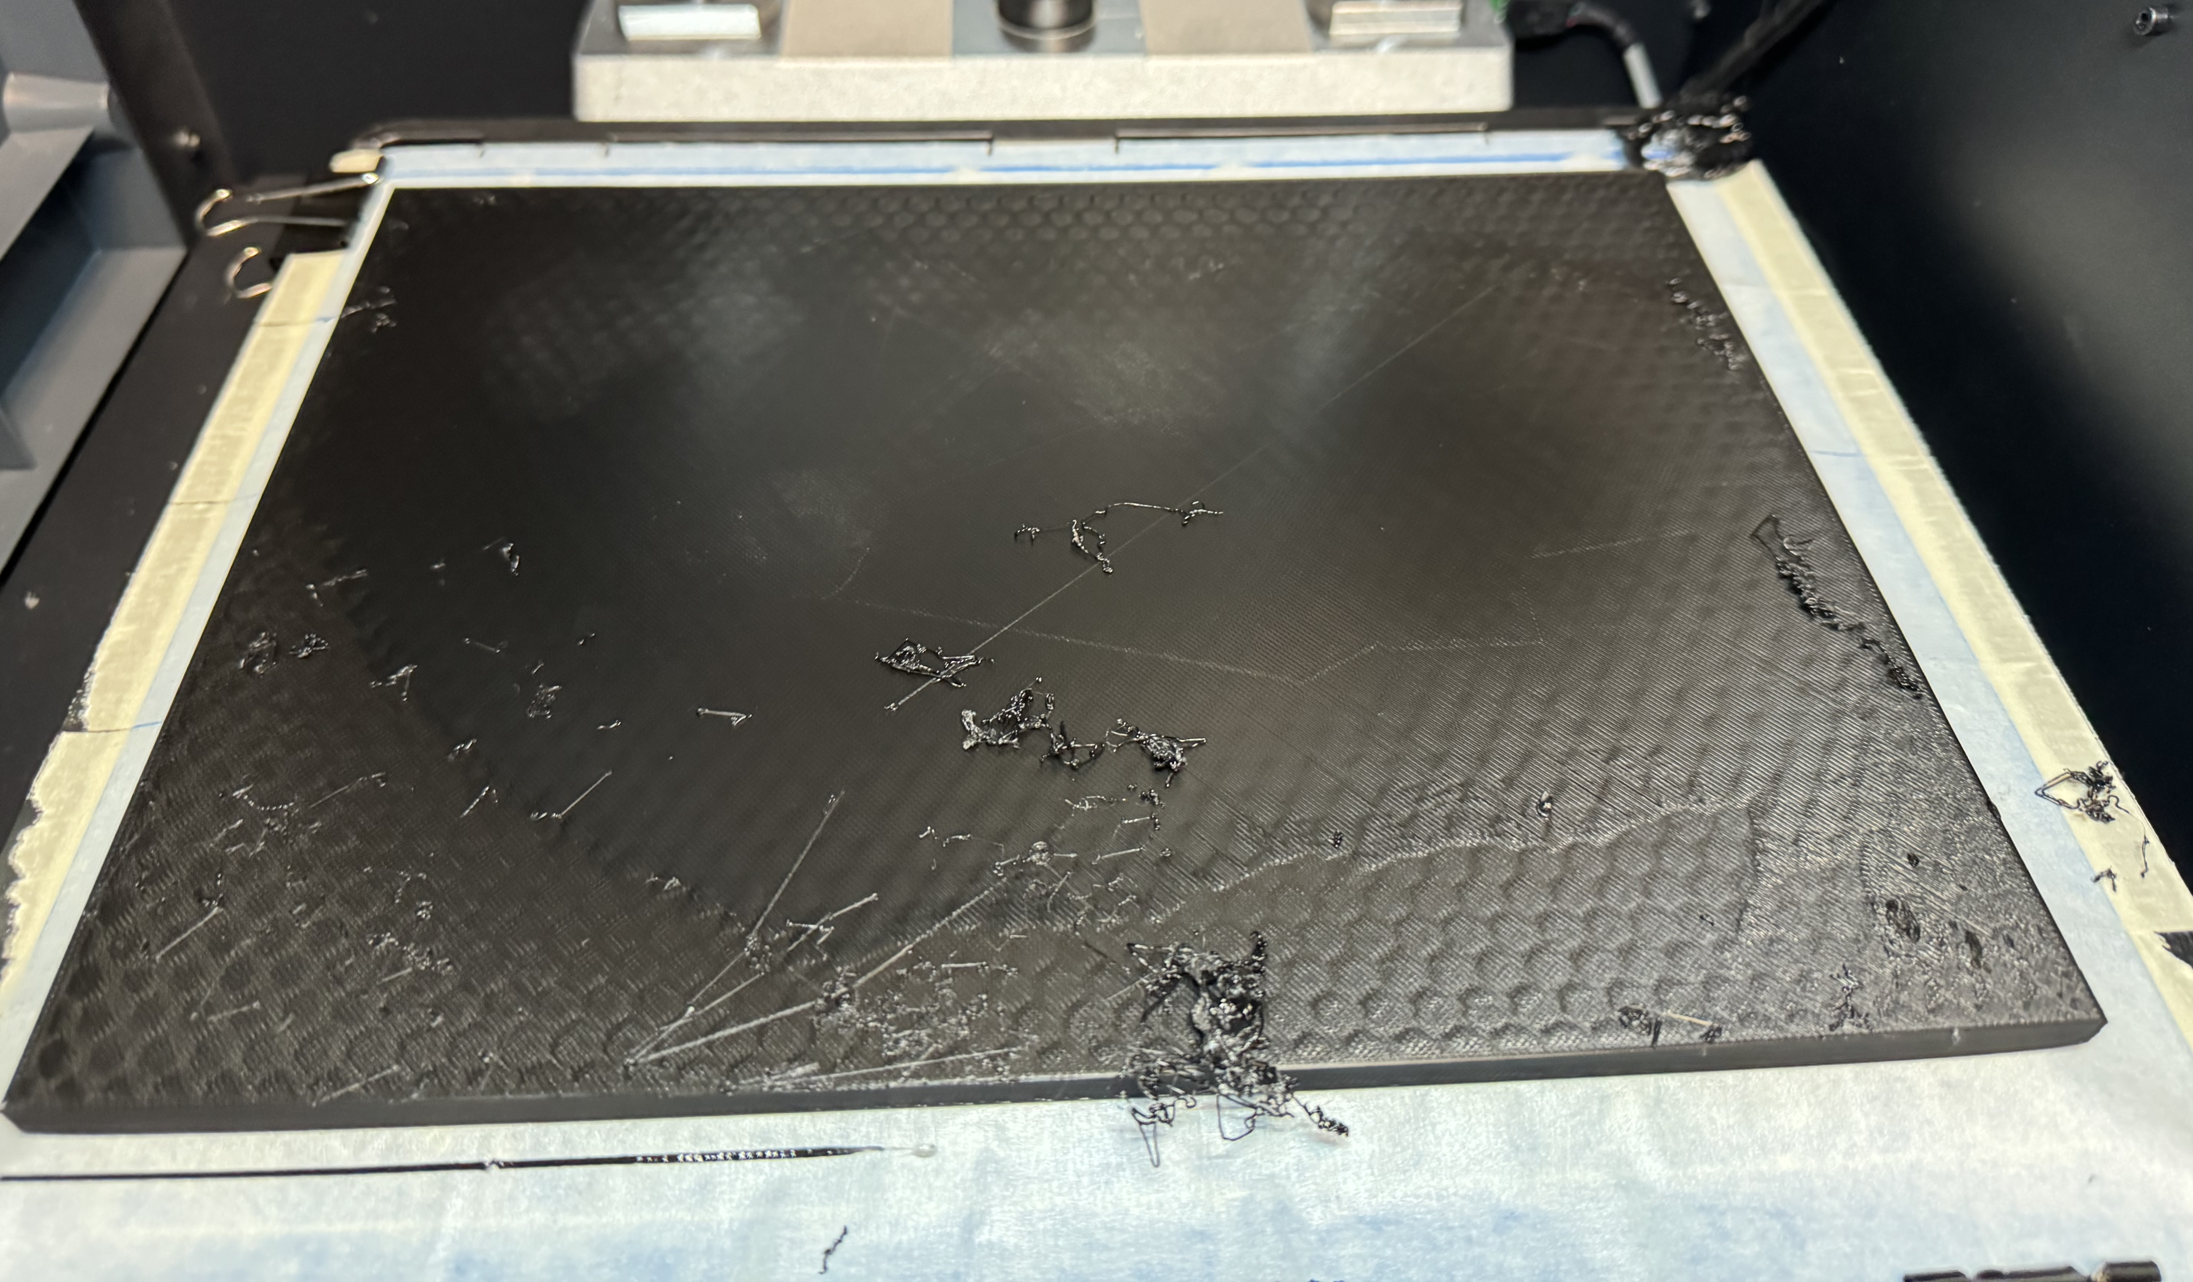
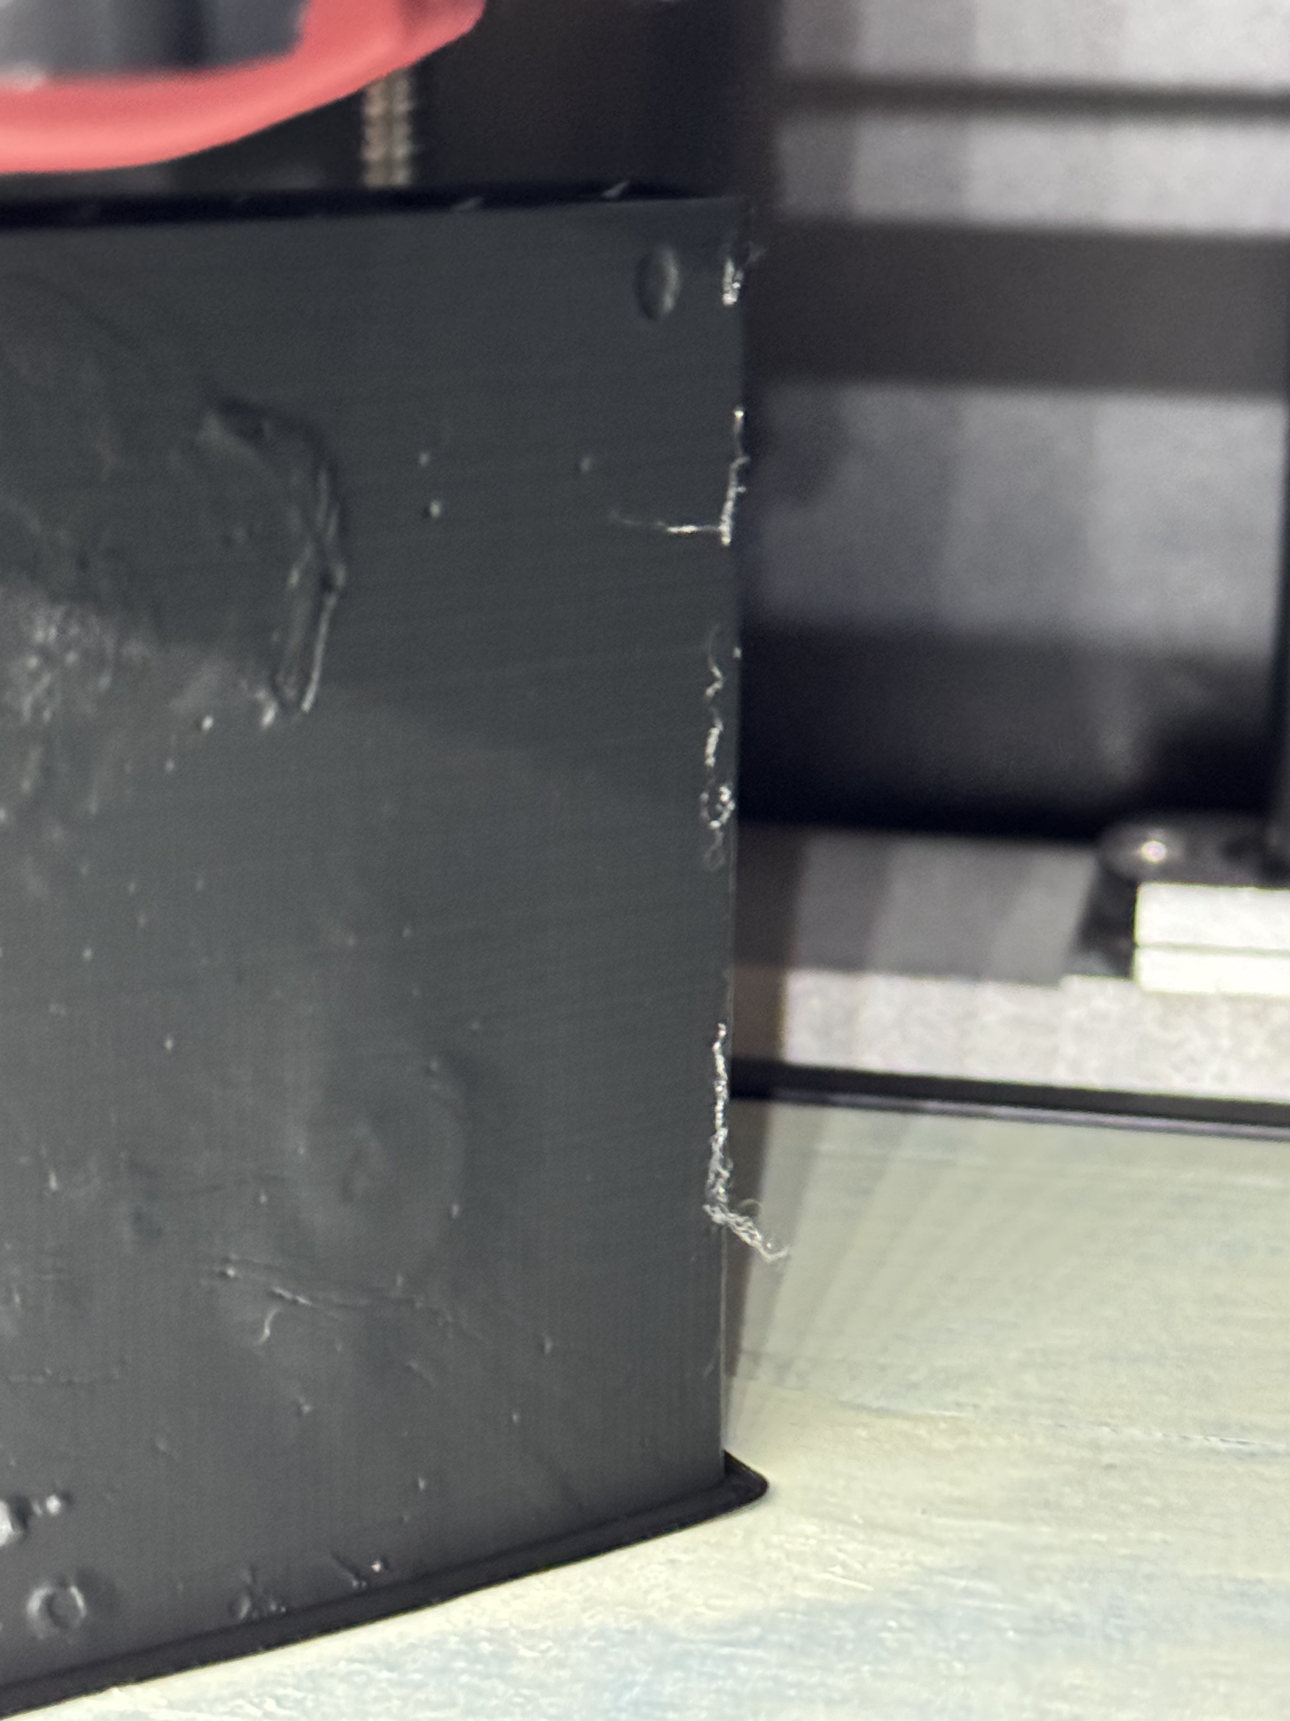
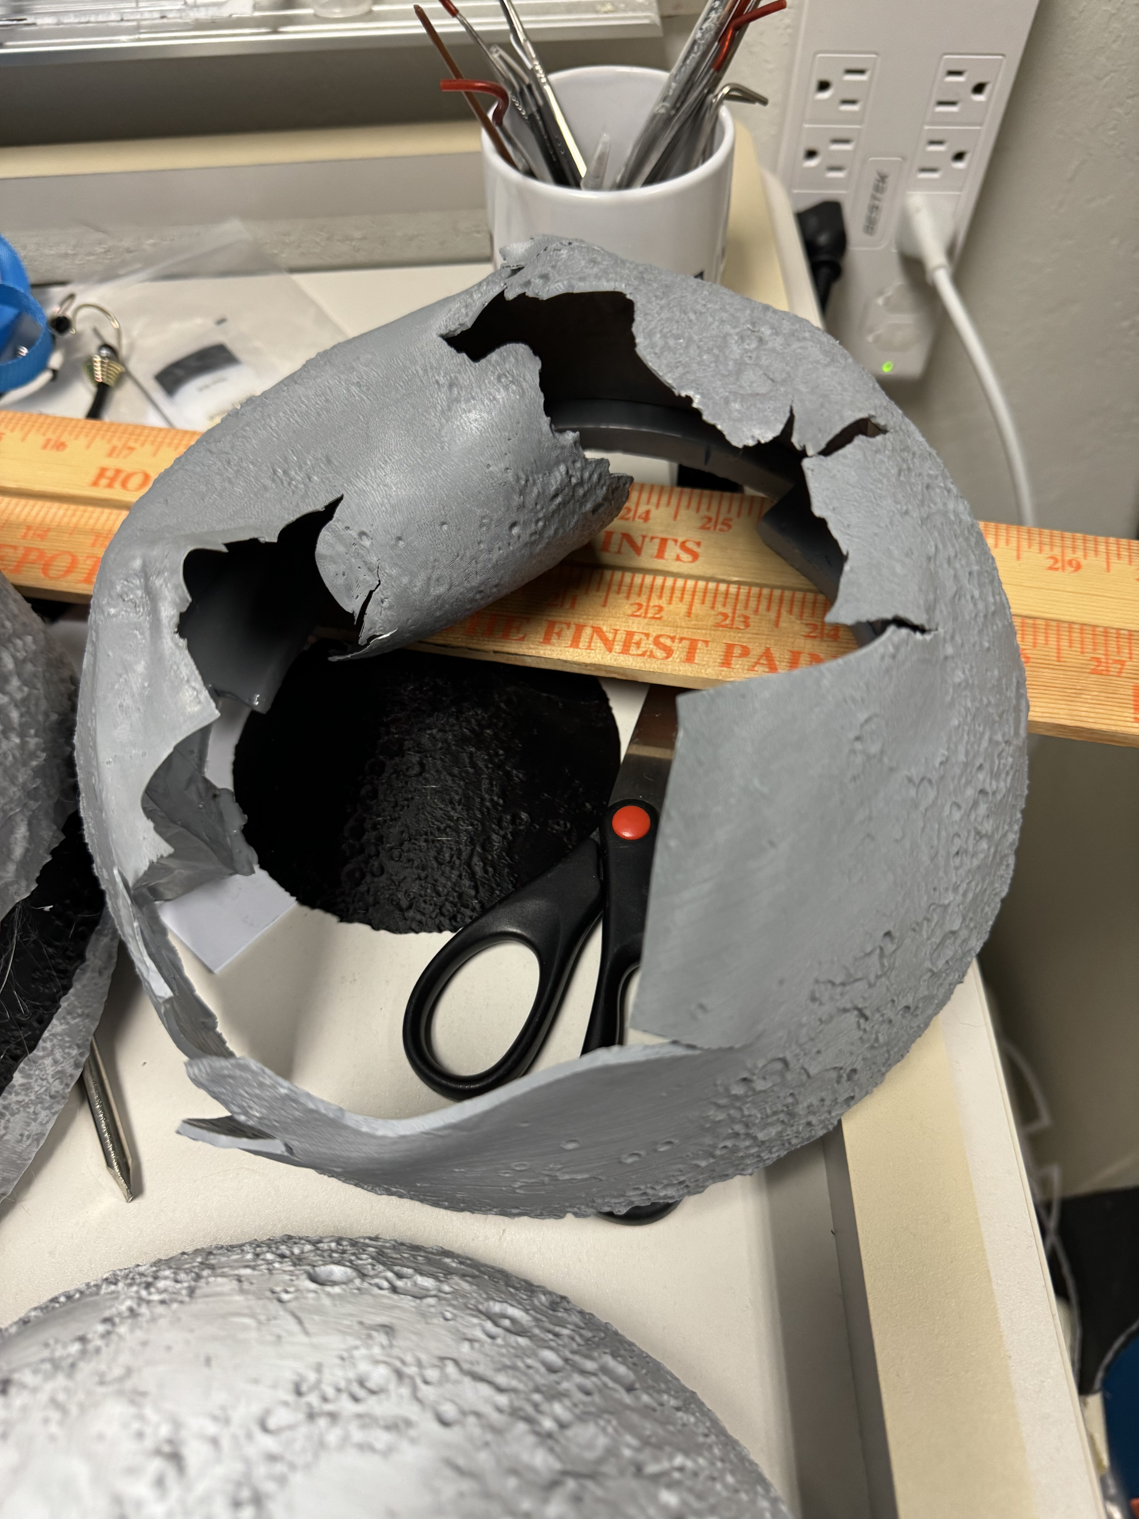
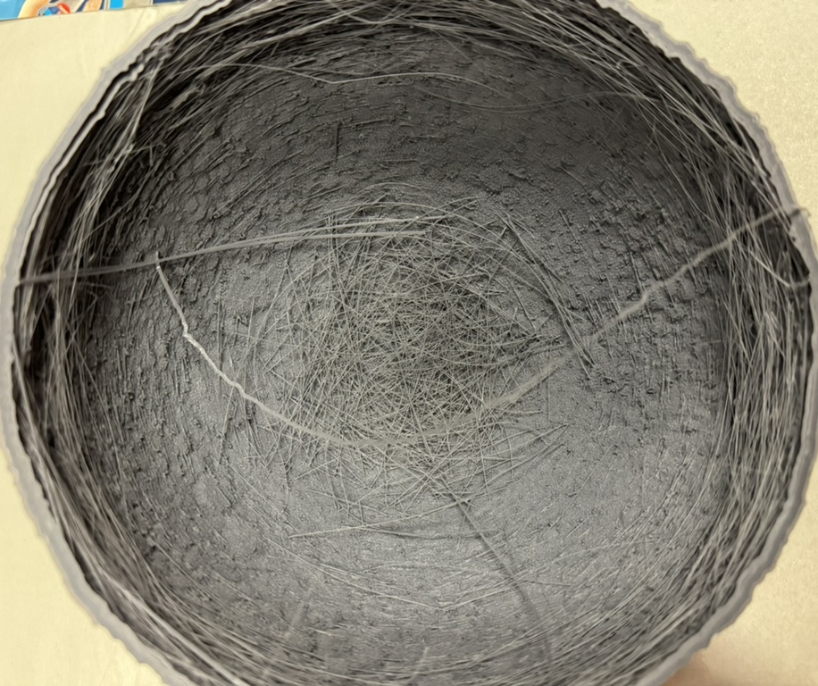
What Does it Take to Make a Model?
1. Printing, and what can go wrong…
Notes:
I came into the project with no experience in what I was working with except for the fact that I have previously taken planetary science courses.
Not only did I have no experience with the software and 3D printers, we used a new printer that even Steve hadn’t used before.
Sometimes prints don’t go to plan…
Resolution Requires Time…

Slide 8
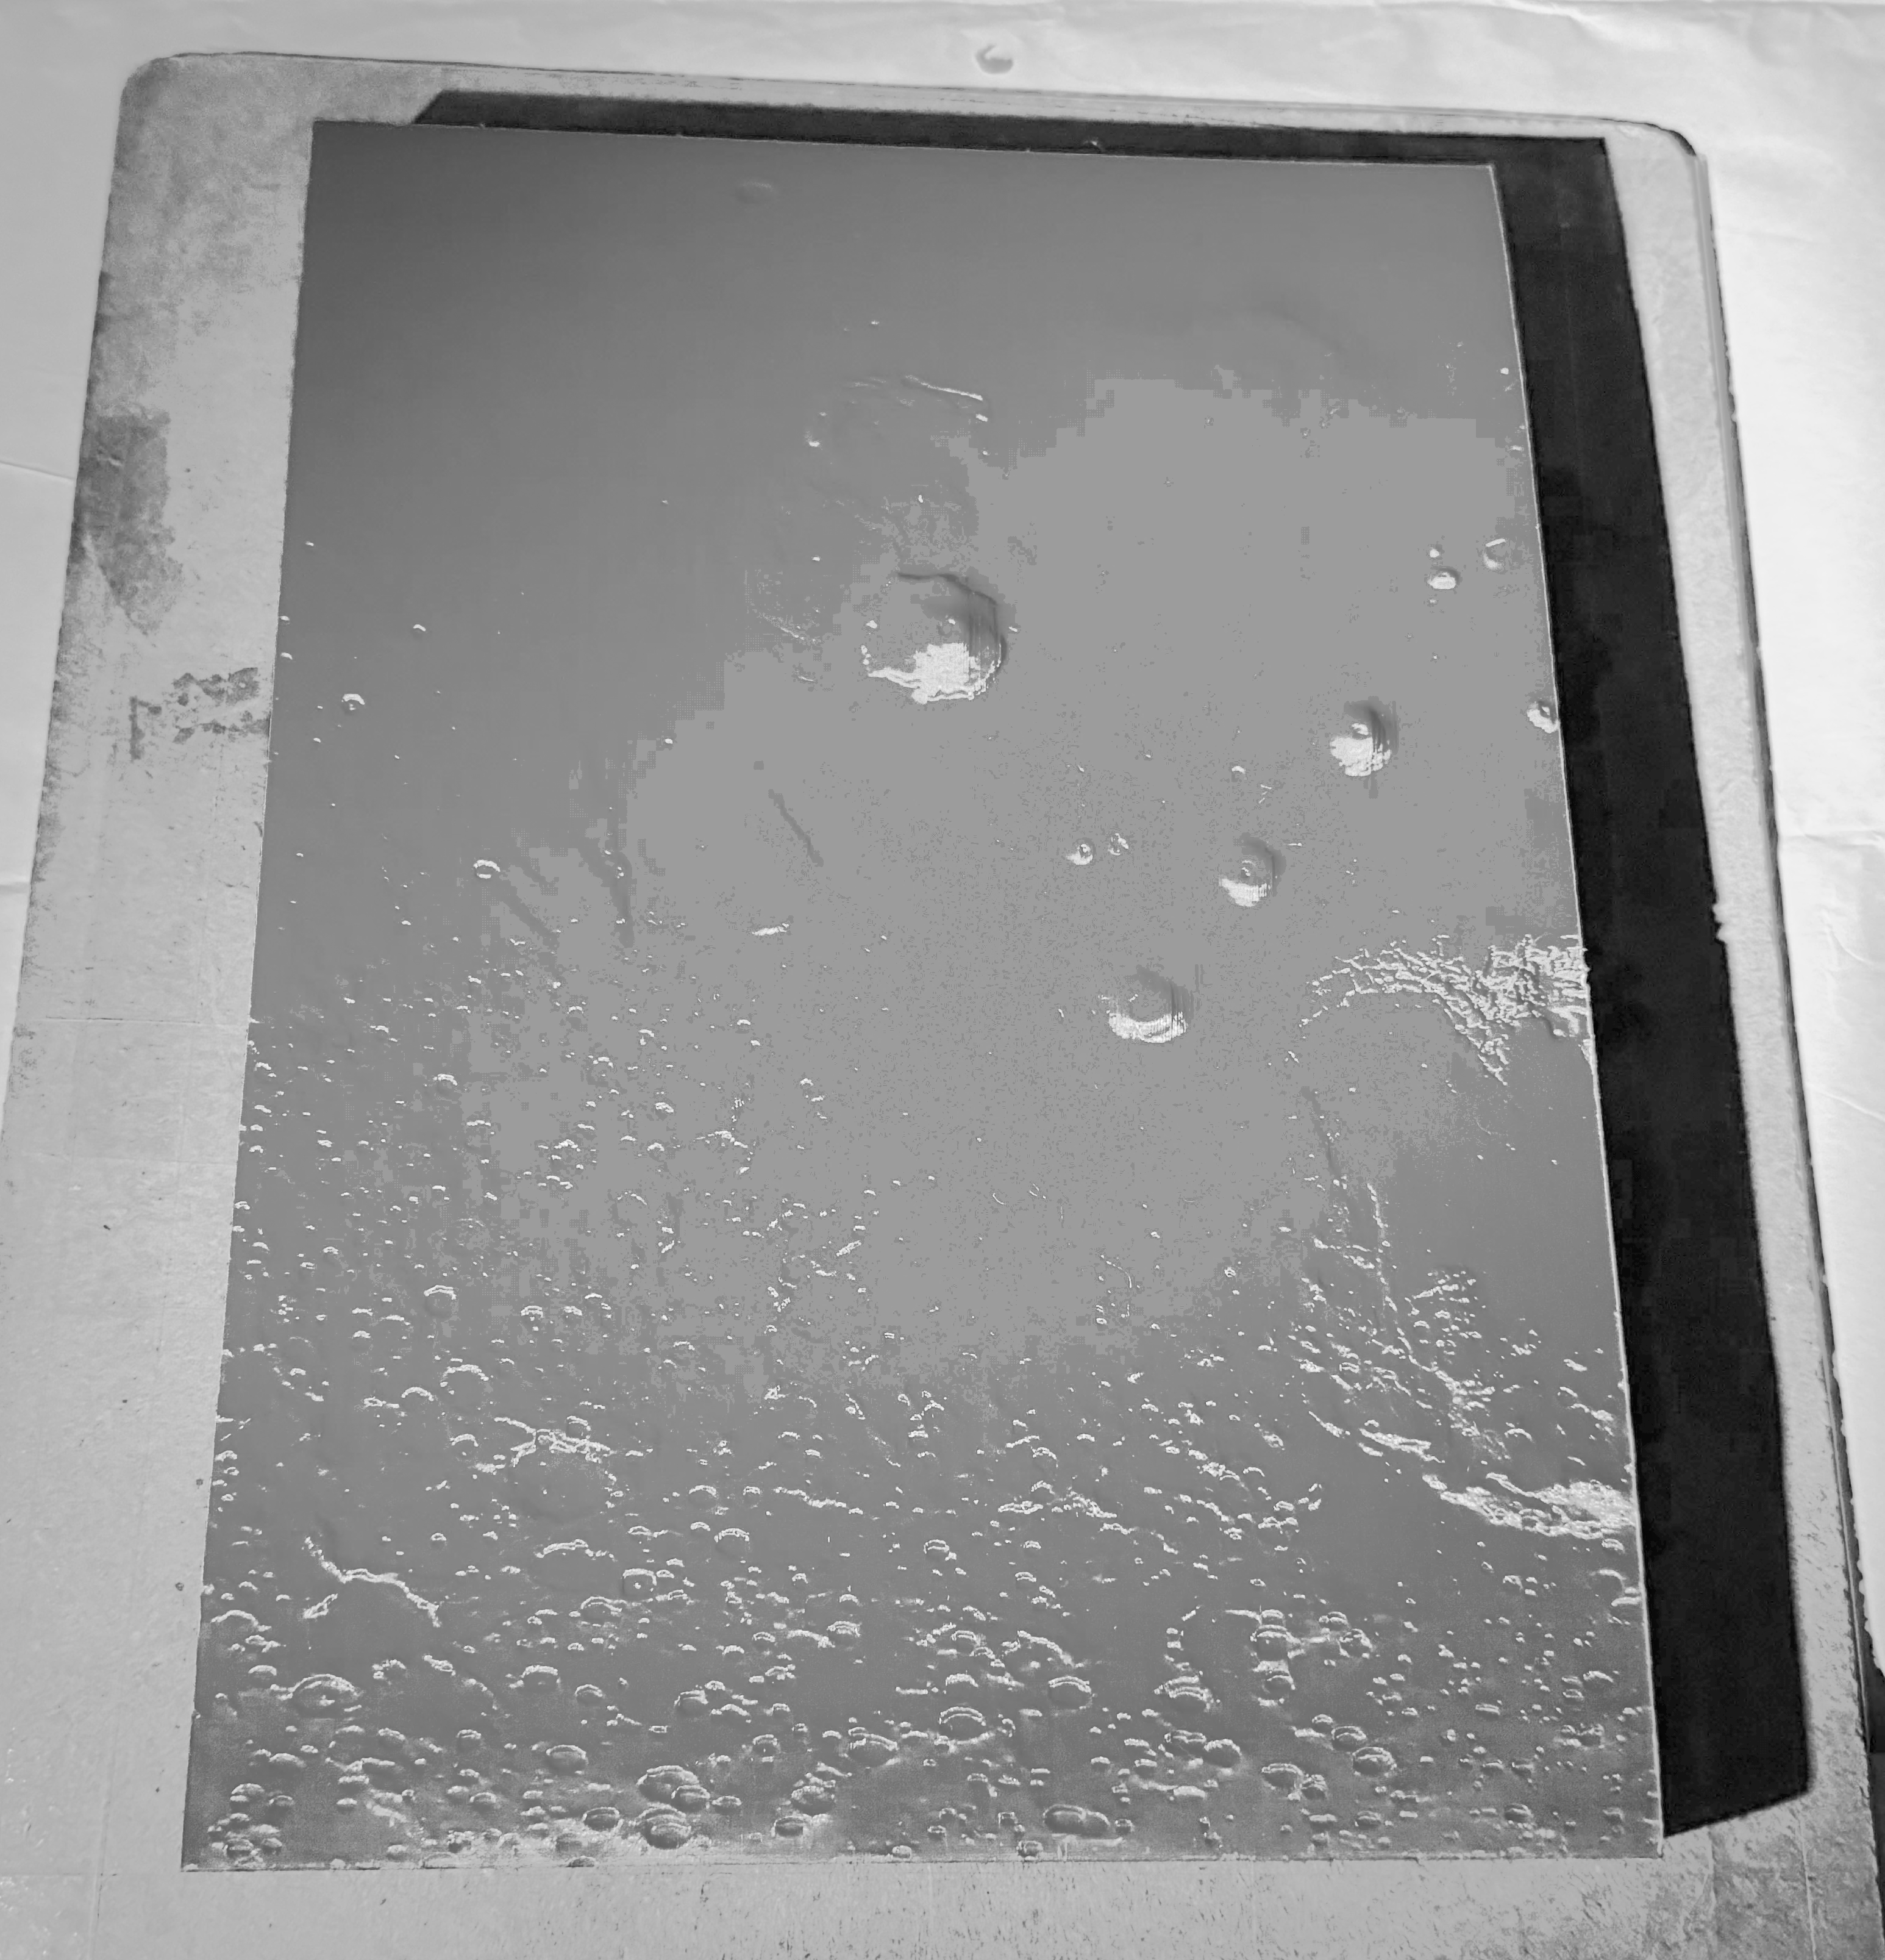
What Does it Take to Make a Model?
Olympus Mons
Alba Mons
1. Printing, and what goes wrong…and right
A quadrant of Mars like this one takes over 100 hours to print and over 300 g of filament!
Tharsis Montes
Tharsis Rise
Notes:
Filament PLA cornstarch based filament, biodegradable

Slide 9
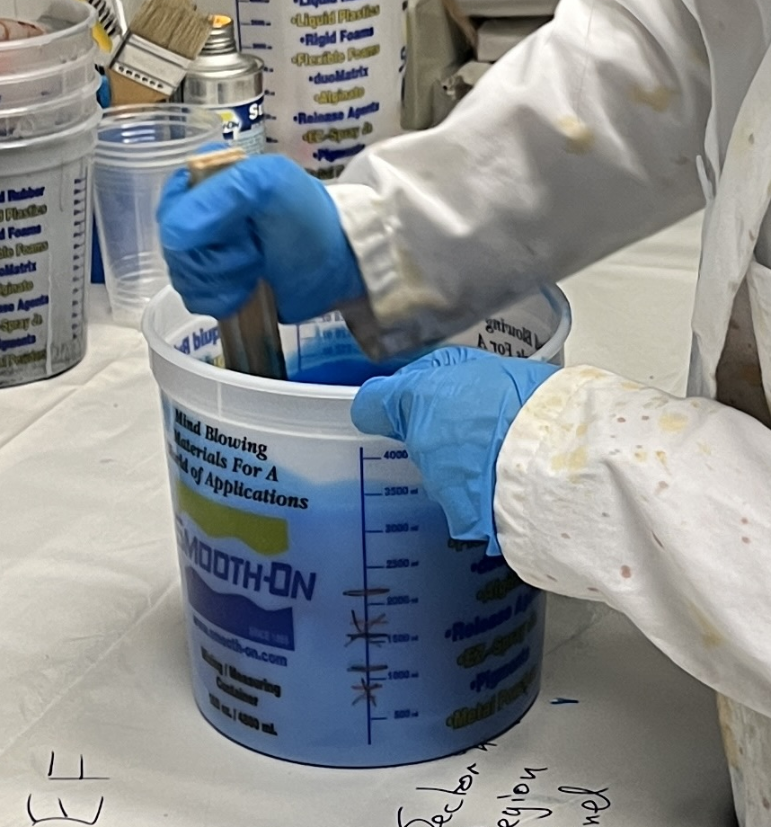
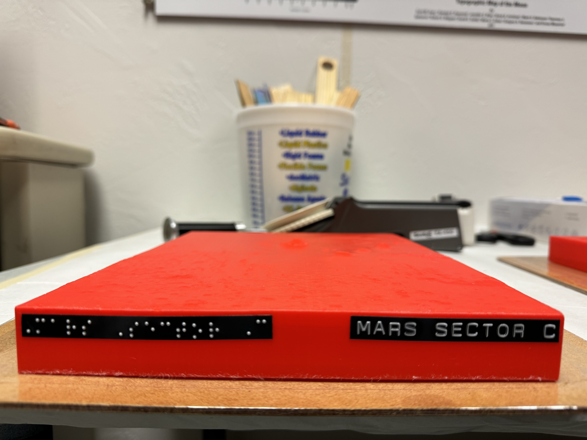
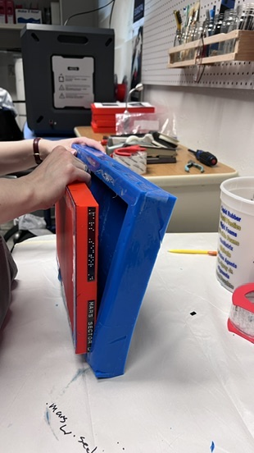
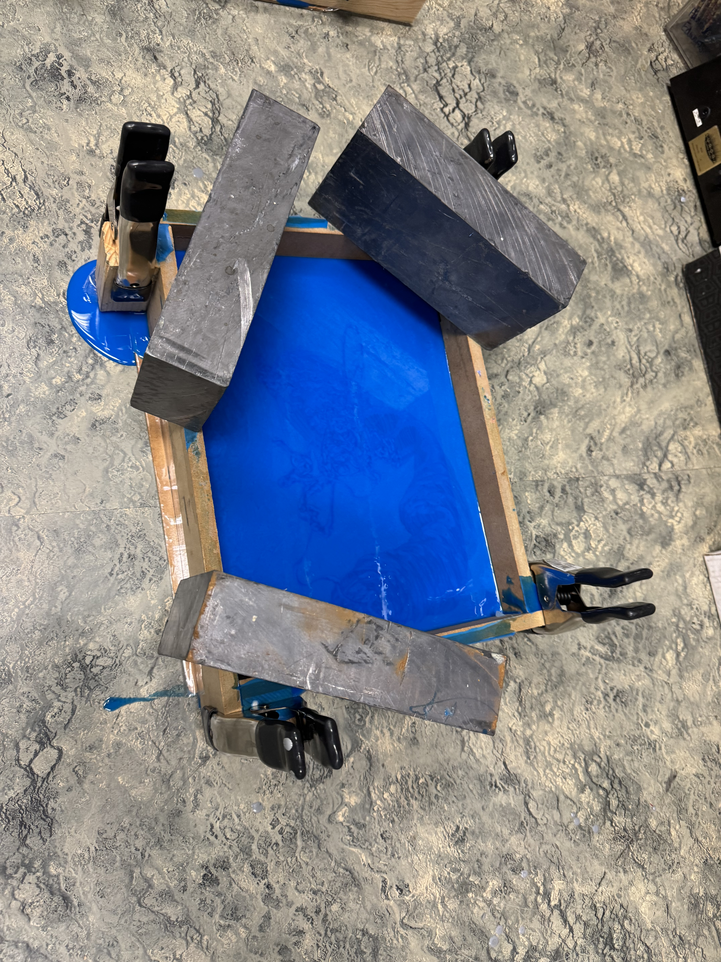
What Does it Take to Make a Model?
(i)
(ii)
2. Making a Mold
  Prepare Print (Lebel, Secure to Base)
  Mix Rubber Solution
  Pour and Cure (Let Cure for 24 hours)
  Free Mold!
(iii)
(iv)

Slide 10
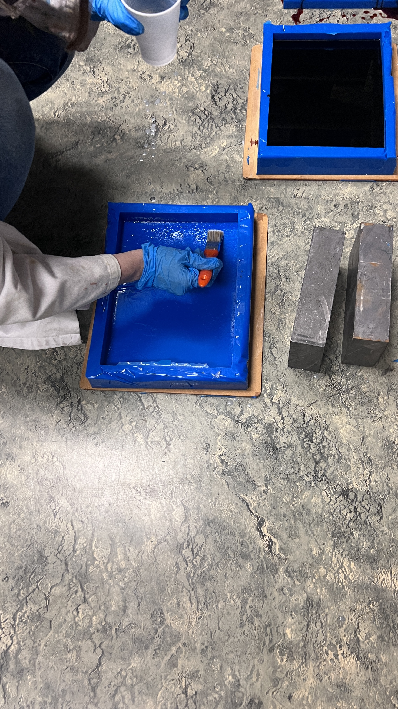
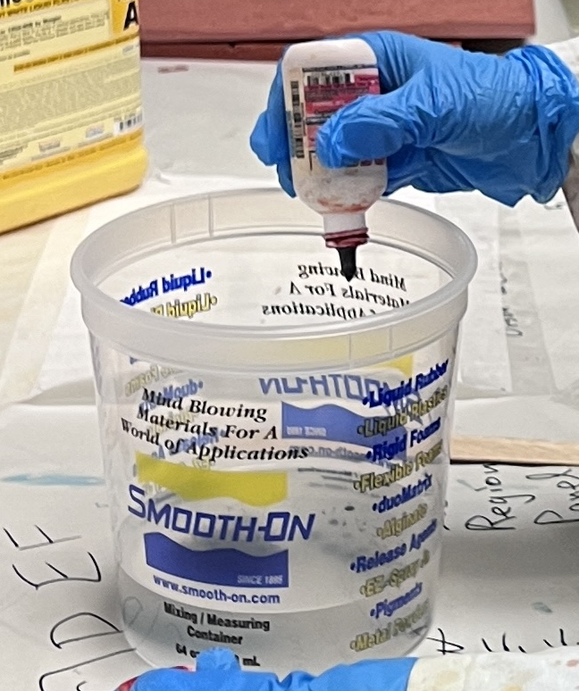
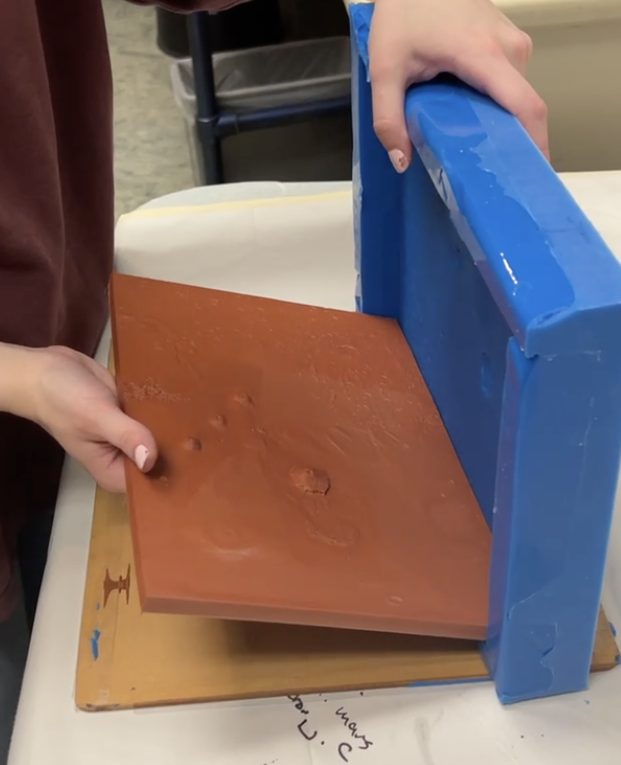
What Does it Take to Make a Model?
(i)
(ii)
3. Casting a Model
  Prepare Mold (coat in release agent)
  Mix Cast Solution (exothermic!)
  Pour and Cure (let cure for 30 minutes)
  Free Cast! (and reuse!)
(iii)
(iv)

Slide 11
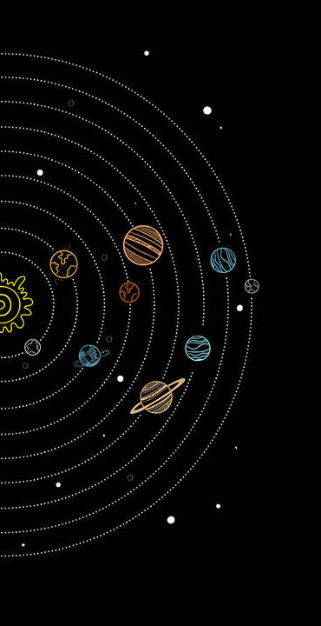
What’s Next?
Curriculum
Tactile Models
Student Engagement
Source: Fine Art America
Notes:
Since Steve is a planetary science professor at the UofA, we plan on testing any tactile models with his students as a way to determine how effective hey are in supplementing material before launching the full course.

Slide 12
Thank You

